Slide 1

HOTEL BOOKING ANALYSIS

Slide 2

1
AGENDA
2
DATA DESCRIPTION
3
DATA SUMMERY
5
BIVARIATEBIVARIAT ANALYSIS
6
MULTIVARIATE ANALYSIS
4
UNIVARIATE ANALYSIS
HOTEL BOOKING ANALYSIS
7
SOLUTION TO BUSINESS OBJECTIVE
8
CONCLUSION

Slide 3
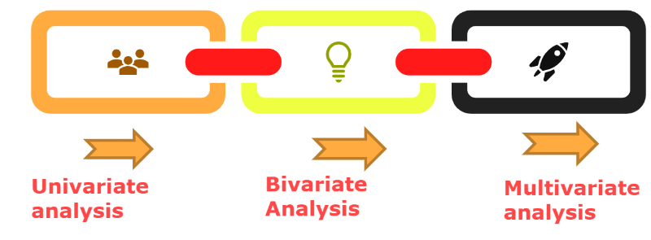
AGENDA :
We were given a year hotel booking dataset and I analyzed it as follows :

Slide 4
DATASET SUMMERY
Basic summary of dataset
In this dataset, there are 119390 rows and 32 columns.
In this dataset, there are both duplicates and missing values available. So, I have to deal with that and as a result, I have replaced the null and missing values and also dropped the duplicate values.
In this project, I divided the data manipulation workflow into three categories i.e. Data Collection, Data cleaning & and manipulation, and EDA
So, I explored and analyzed the data to discover important factors that govern the bookings.

